Slide 1
Data-Flow Testing
Data-flow testing uses the control flow graph to explore the unreasonable things that can happen to data(i.e., anomalies).
Consideration of data-flow anomalies leads to test path selection strategies that fill the gaps between complete path testing and branch or statement testing.

Slide 2
Data-flow testing is the name given to a family of test strategies based on selecting paths through the program’s control flow in order to explore sequences of events related to the status of data objects.

Slide 3
Data Object Categories
• (d) Defined, Created, Initialized
• (k) Killed, Undefined, Released
• (u) Used:
– (c) Used in a calculation
– (p) Used in a predicate

Slide 4
(d) Defined Objects
An object (e.g., variable) is defined when it:
– appears in a data declaration
– is assigned a new value
– is a file that has been opened
– is dynamically allocated

Slide 5
(u) Used Objects
An object is used when it is part of a computation or a predicate.
• A variable is used for a computation (c) when it appears on the RHS (sometimes even the LHS in case of array indices) of an assignment statement.
• A variable is used in a predicate (p) when it appears directly in that predicate.

Slide 6
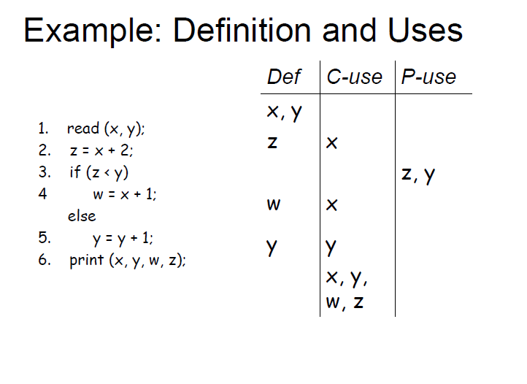

Slide 7
Static vs Dynamic Anomaly Detection
Static analysis, also called static code analysis, is a method of computer program debugging that is done by examining the code without executing the program. The process provides an understanding of the code structure
Static Analysis is analysis done on source code without actually executing it.
E.g., Syntax errors are caught by static analysis.

Slide 8
Performed on requirement design or code without actually executing the software or before the code is actually run.
Goal of static analysis is to find the defects whether or not they may cause failure.
Static analysis find defects rather than failures.
Static analysis can be done by a machine to automatically “walk through” the source code and detect noncomplying rules.
The classic example is a compiler which finds lexical, syntactic and even some semantic mistakes.

Slide 9
When developers performs code analysis, they usually look for
Lines of code
Comment frequency
Proper nesting
Number of function calls
Cyclomatic complexity
Can also check for unit tests
Quality attributes that can be the focus of static analysis:
Reliability
Maintainability
Testability
Re-usability
Portability
Efficiency

Slide 10
Static Analysis Deficiencies
Current static analysis methods are inadequate for:
Dead Variables: Detecting unreachable variables is unsolvable in the general case.
Arrays: Dynamically allocated arrays contain garbage unless they are initialized explicitly. (-u anomalies are possible)
Pointers: Impossible to verify pointer values at compile time.
False Anomalies: Even an obvious bug (e.g., ku) may not be a bug if the path along which the anomaly exists is unachievable.

Slide 11
Dynamic Analysis is analysis done as a program is executing and is based on intermediate values that result from the program’s execution.
– E.g., A division by 0 error is caught by dynamic analysis.
• If a data-flow anomaly can be detected by static analysis then the anomaly does not concern testing. (Should be handled by the compiler.)

Slide 12
Data-Flow Modeling
Data-flow modeling is based on the control flowgraph.
Each link is annotated with:
– symbols (e.g., d, k, u, c, p)
– sequences of symbols (e.g., dd, du, ddd)
that denote the sequence of data operations on that link with respect to
the variable of interest.

Slide 13
Simple Path Segments
A Simple Path Segment is a path segment in which at most one node is visited twice.
– E.g., (7,4,5,6,7) is simple.
Loop-free Path Segments
A Loop-free Path Segment is a path segment for which every node is visited at most once.
– E.g., (4,5,6,7,8,10) is loop-free.
– path (10,11,4,5,6,7,8,10,11,12) is not loop free because nodes 10 and 11 are visited twice.
Therefore, a simple path may or may not be loop-free.

Slide 14
du Path Segments
A du Path is a path segment such that if the last link has a use of X, then the path is simple and definition clear
Def-use Associations.
A def-use association is a triple (x, d, u,), where:
x is a variable,
d is a node containing a definition of x,
u is either a statement or predicate node
containing a use of x, and there is a sub-path in the flow graph from d to u with no other definition of x between d and u.

Slide 15
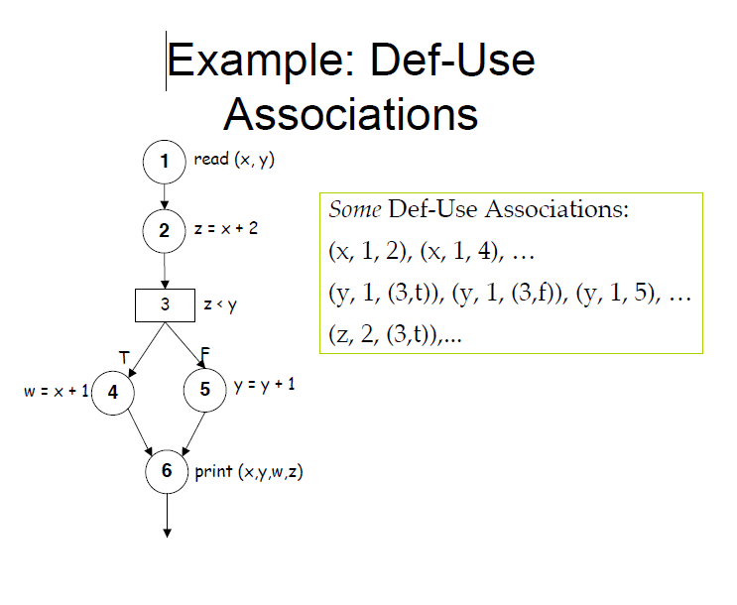

Slide 16
THANKU

